Slide 1
Investigation of Dogs of Zurich
Kasey Larsen

Slide 2
Questions Asked:
When marketing dog care products to customers the following information care be important:
Which City Quarter has the highest number of dog owners?
In that City Quarter, what is the most popular dog? Dog color? Dog Age?
Are women or men more likely to be dog owners? Does this trend hold true in the City Quarter with the most dog owners?
For all dog owners, how to the ages of the dogs compare to the age of the owner?

Slide 3
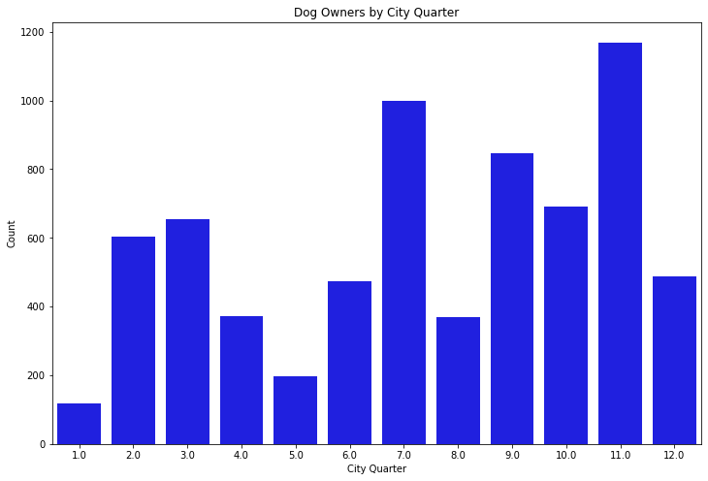
The 11.0 City Quarter has the highest collection of dog owners.
Notes:
plt.figure(figsize = [12, 8])
sns.countplot(data = df, x = 'City_Quarter', color='b')
plt.title('Dog Owners by City Quarter')
plt.xlabel('City Quarter')
plt.ylabel('Count');

Slide 4
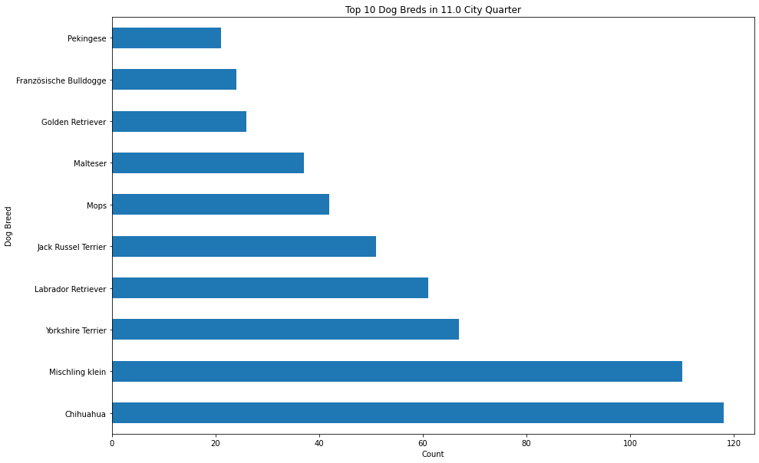
Chihuahua is the most popular dog color in the 11.0 City Quarter.

Slide 5
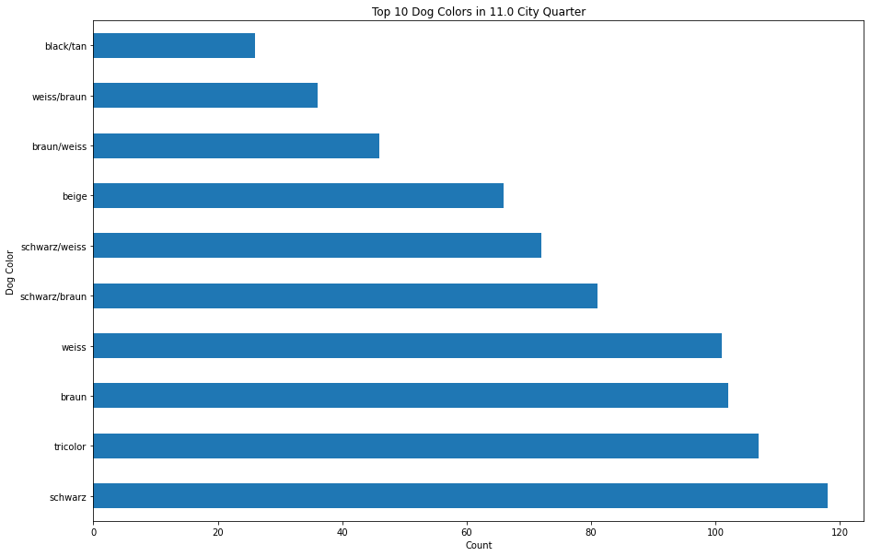
Schwarz is the most popular dog color in the 11.0 City Quarter.

Slide 6
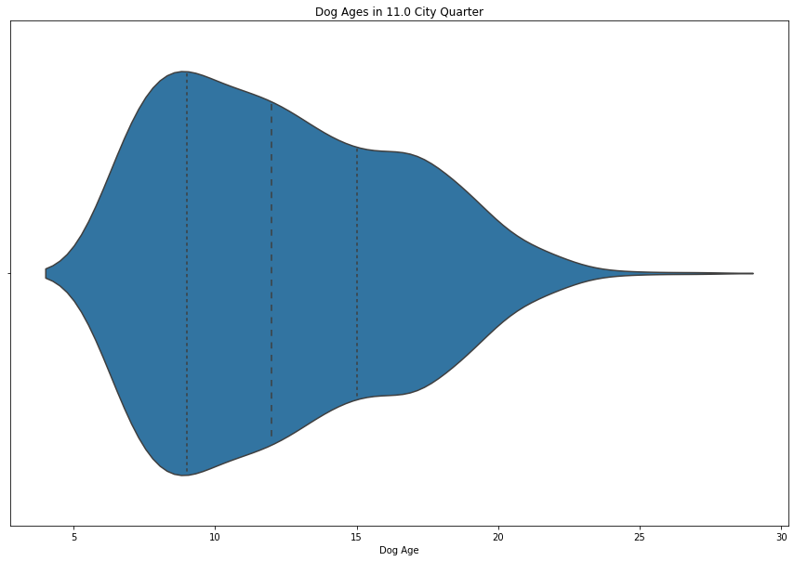
The average dog age is around 12 in the 11.0 City Quarter

Slide 7
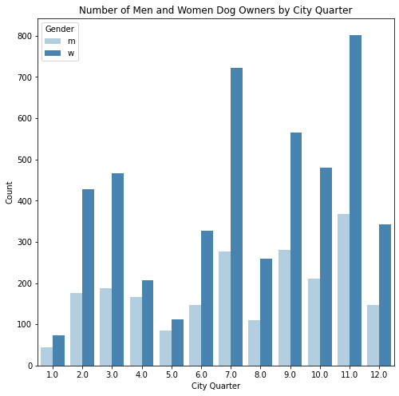
Every City Quarter has more women dog owners than men. The 11.0 City Quarter has one of the larger gaps.

Slide 8
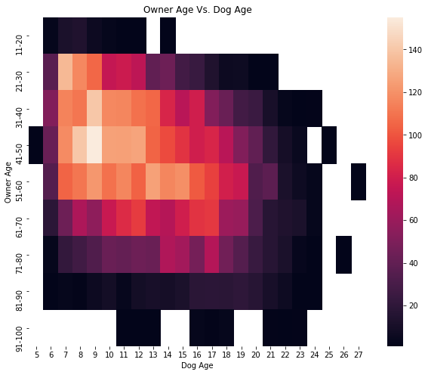
There are the most dog owners 41-50 years old that have dogs that are 9.

Slide 9
Conclusions
For marketing dog products to users:
The 11.0 City Quarter is the most populated.
In the 11.0 City Quarter, the major breeds are smaller dogs, with 50% of those dogs being between 9-15 years old.
Women are more likely to be dog owners than men.
20-60 year olds have a large portion of the dogs, with 41-50 years having dogs that are about 9 being the larges population.

